Slide 1

Team Apex
Brisbane Boys’ College, Australia

Slide 2
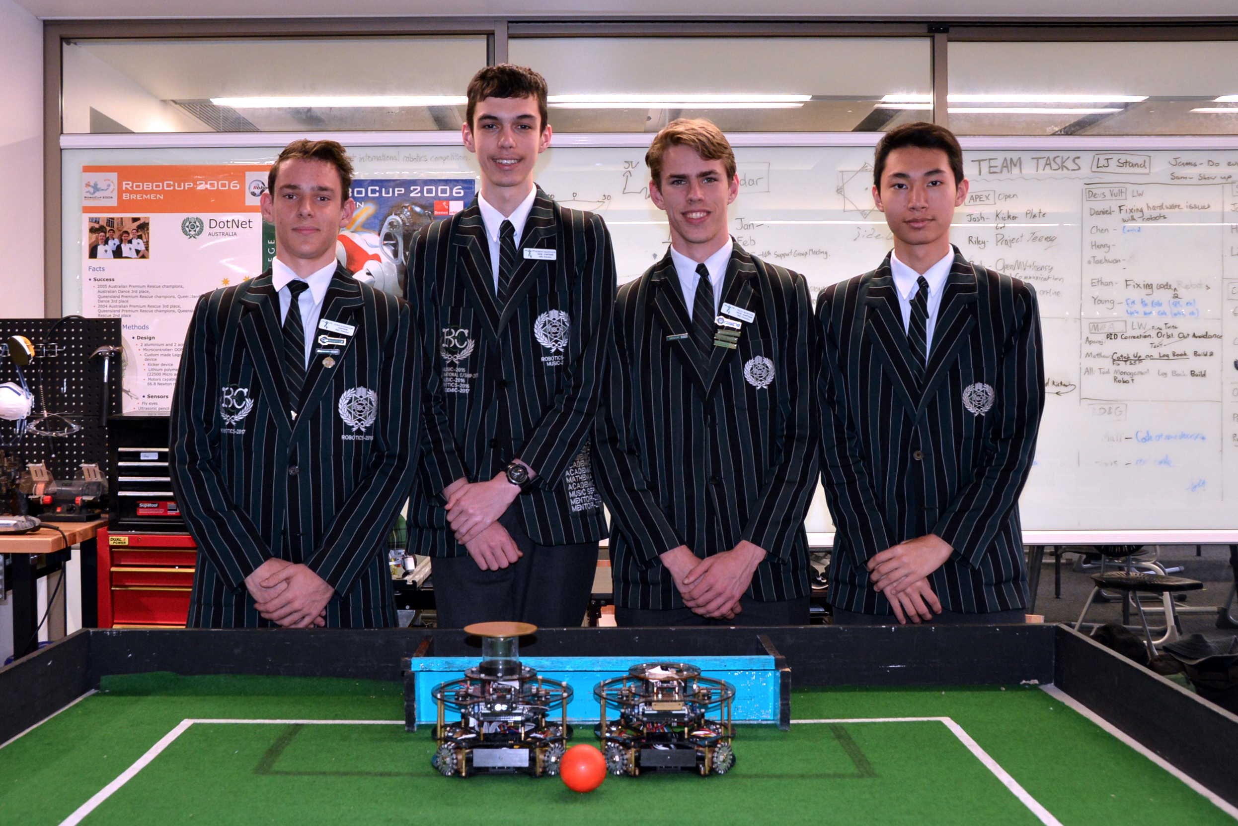
TEAM DYNAMIC
Joshua Barclay
Design
Robert McArthur
Optical Software
Riley Bowyer
Electrical
Jason Wang
Sensory and Communication Logic

Slide 3
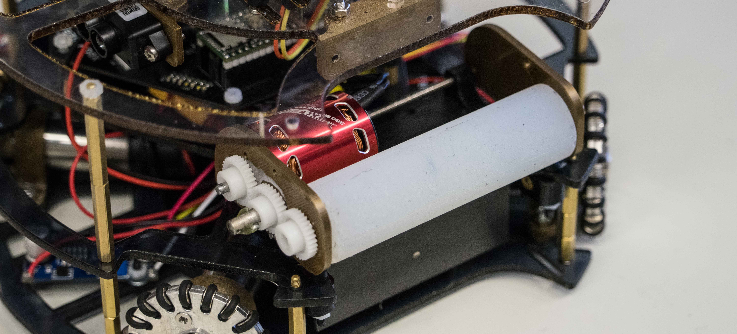
Chassis Design
Team Apex – Australia

Slide 4
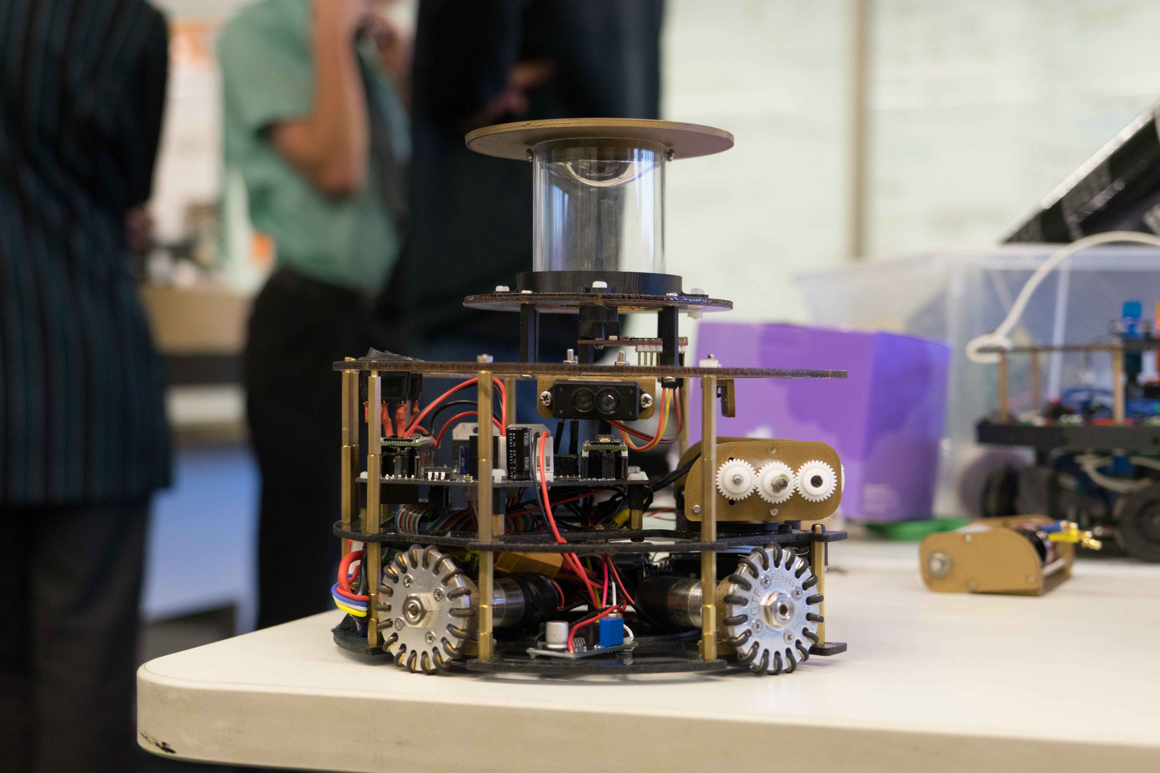
ROBOT STRUCTURE
360 camera
Team APEX have created two almost identical robots, each comprising of three levels with different components on each plate. Custom made PCBs were utilised to decrease clutter and improve consistency. The major componentry used was:
- 4 x Maxon DCX19 motors
- 4 x LMD18200T motor controllers
- 4 x Omnidirectional wheels
- 4 x Lidar Modules, for use in a field positioning
- 2 x Teensy 3.5 Microcontrollers in a designated slave-master configuration
- 24 Red Light Sensors in a dual ring set-up
- Open MV-M7 camera with object recognition use in conjunction with a 360 degree mirror
- MPU 9250 IMU, dual gyroscope accelerometer
- Light Gate, to detect when ball is captured
- Silicone Dribbler Bar, powered by a trackstar brushless motor
- 2 x HC-05 master-Slave Bluetooth modules for dynamic and advanced strategy
- Linear Solenoid Kicker Circuit
Top plate
Middle plate
Base plate
Design
A variety of CAD software's were used in the design process. Inventor and Fusion 360 were utilised for fast rendering of ideas, and the development of the final design. Fusion 360’s basis around team coordination was useful for group collaboration and ensuring everyone had access to all files. Eagle was used in the design of all electronics, the PCBs designed being compact and utilitarian. These served to increase reliability and room for complexity in design. The new Fusion-Eagle link was especially useful for quick implementation of PCBs into general design. Many iterations of both general design and PCBs were made, each experimenting with different shapes and positioning.

Slide 5
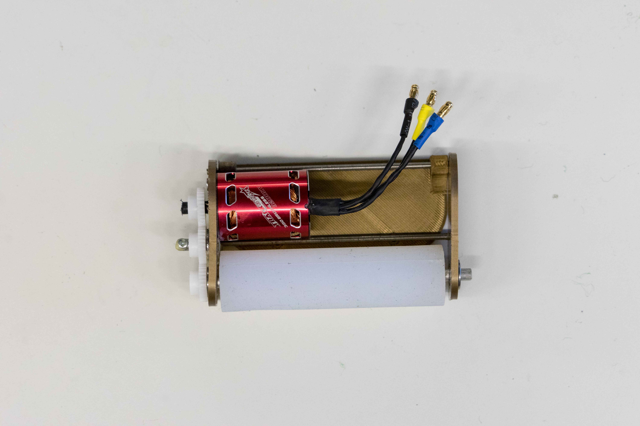
Dribbler
The assembly of the dribbler is mainly 3D printed and designed for maximum control of the ball. The brushless motor spins a custom moulded silicon bar. After the robot has line of sight of the goal, the solenoid is activated kicking the ball. The ability to control the ball, especially with a passive ball relying on visual tracking allows for the robot to move with speed and still have control over the ball. The position of the dribbler on the robot also allows for the silicon bar to grab the top of the ball as it pivots on the 3D print. Elastic material applies constant downwards pressure on the ball, ensuring a constant connection between dribbler and ball.

Slide 6
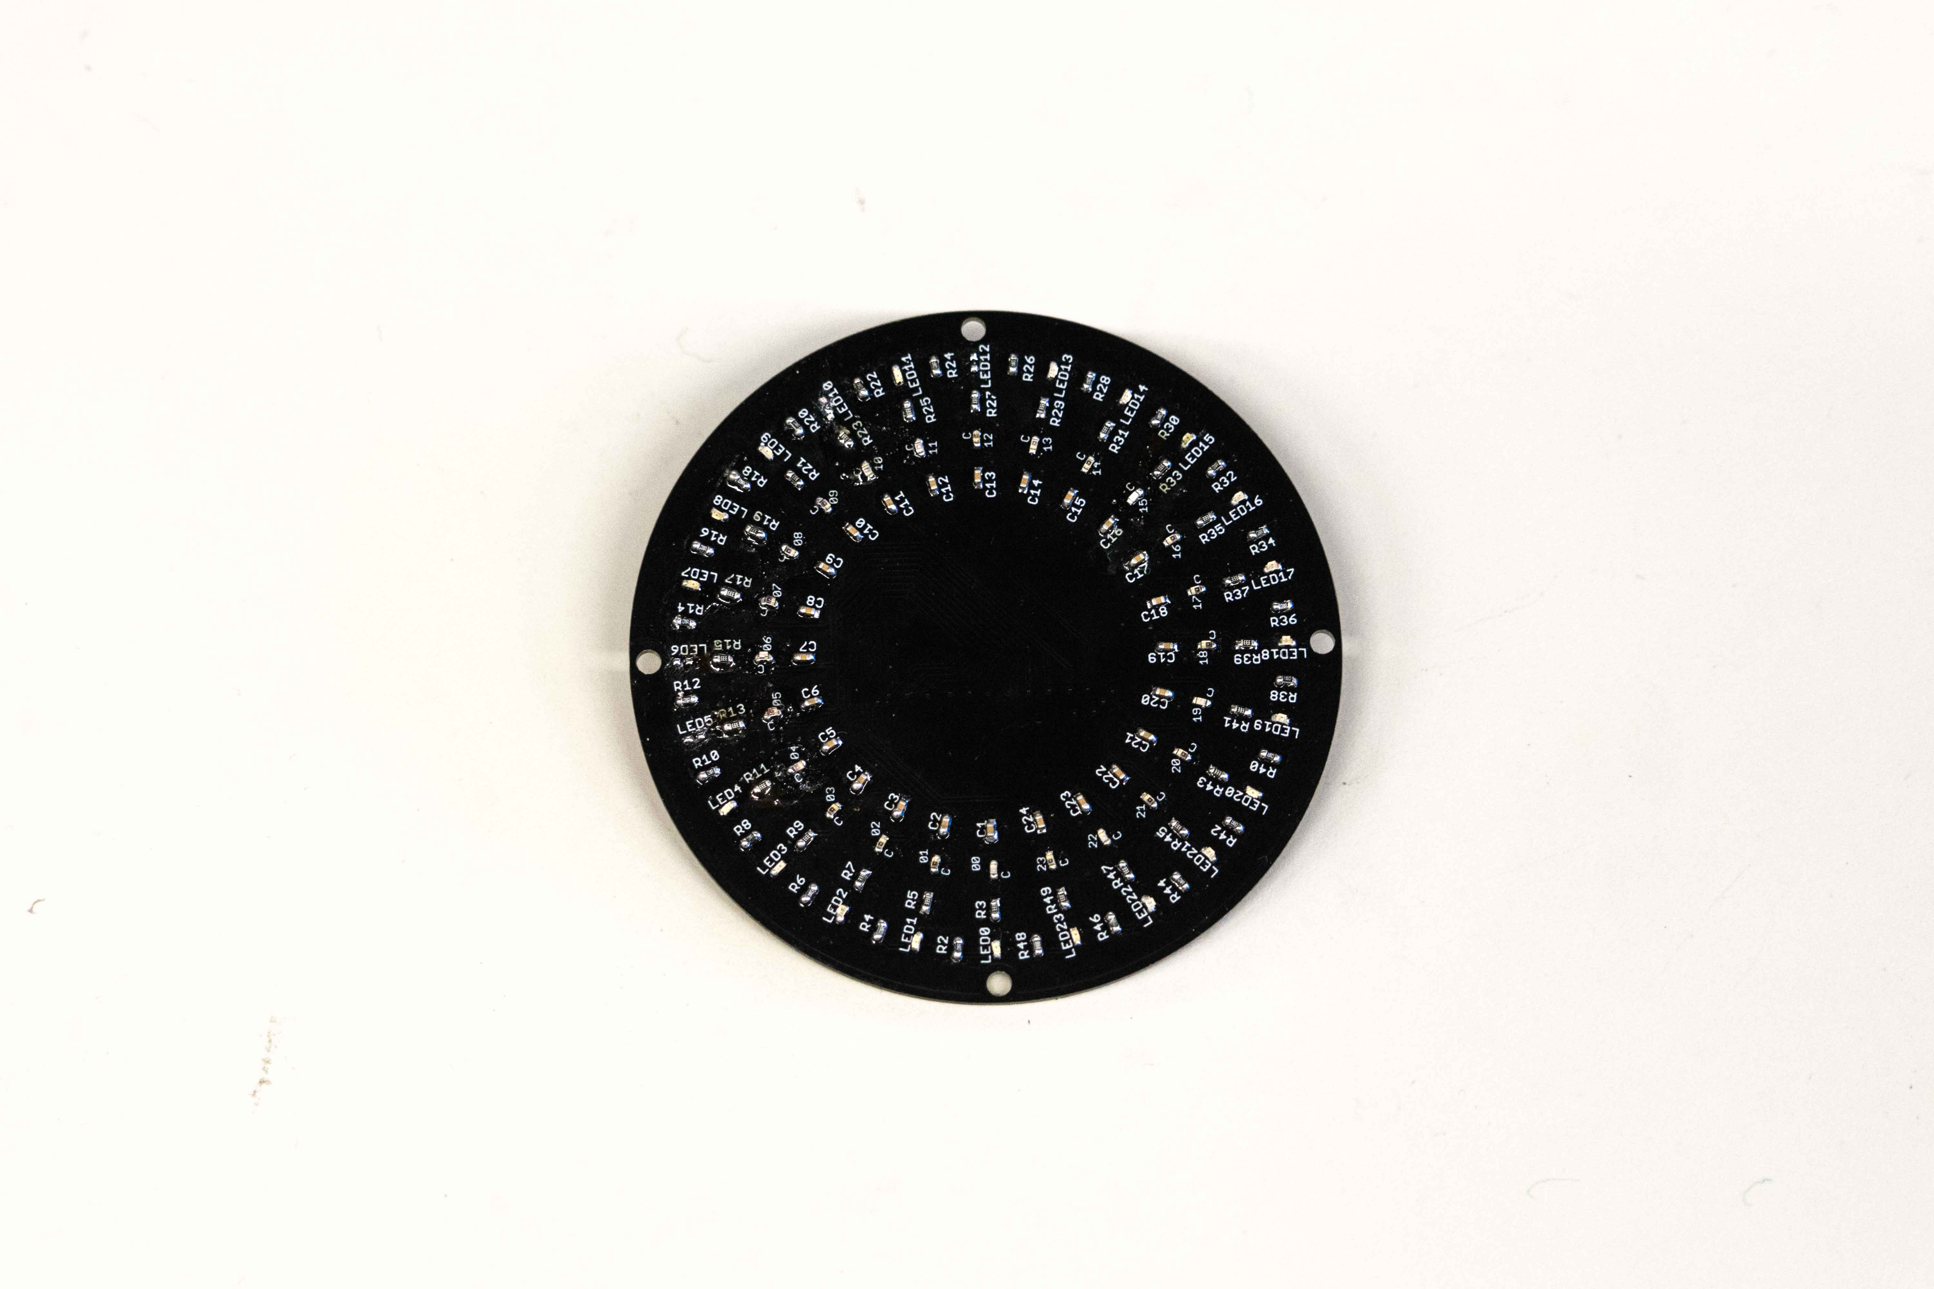
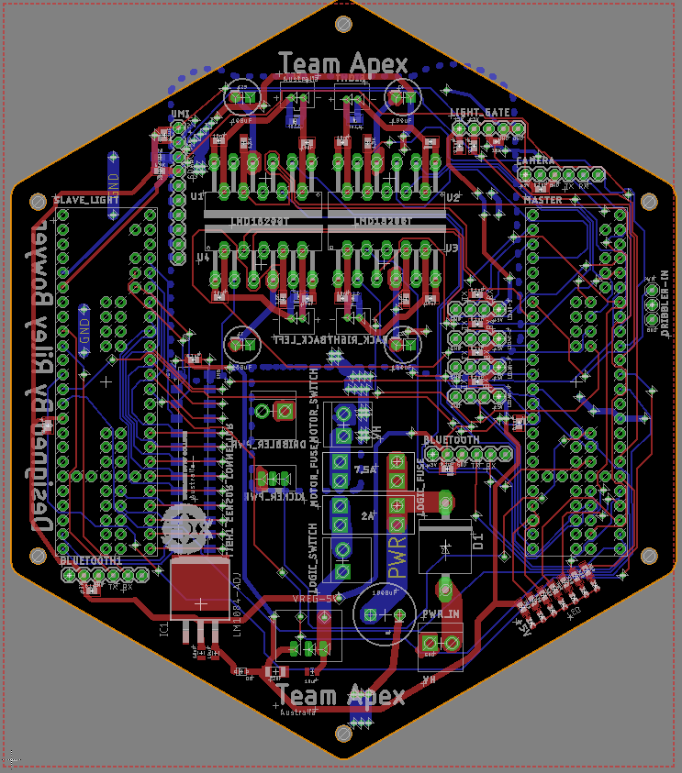
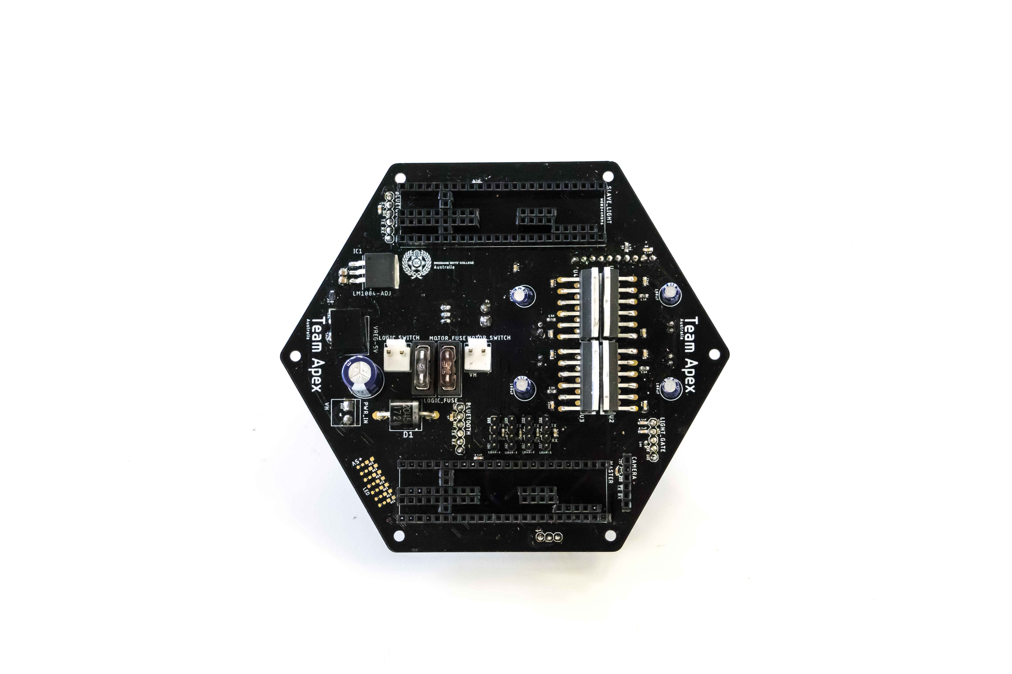
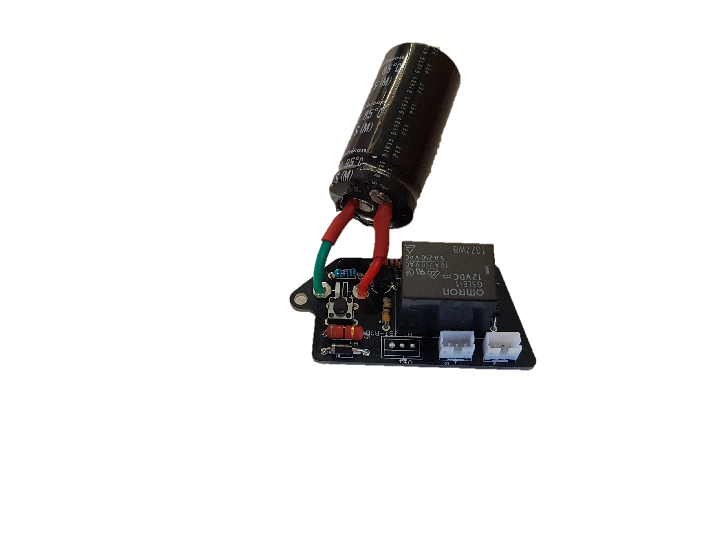
PRINTED CIRCUIT BOARDS
LIGHT PCB
24 sensor circuits in a dual ringed style.
Custom printed circuit boards (PCBs) were developed and designed incorporating years of experience and knowledge from other students.
The reduction of external wiring reduces inconsistency and potential errors, whilst allowing for deeper levels of intricacy.
MAIN PCB
The heart of our robot, containing all major componentry including: IMU, Micro-Controllers, Bluetooth, Camera, etc.
Kicker PCB
A compact charging circuit for use in conjunction with a solenoid.

Slide 7
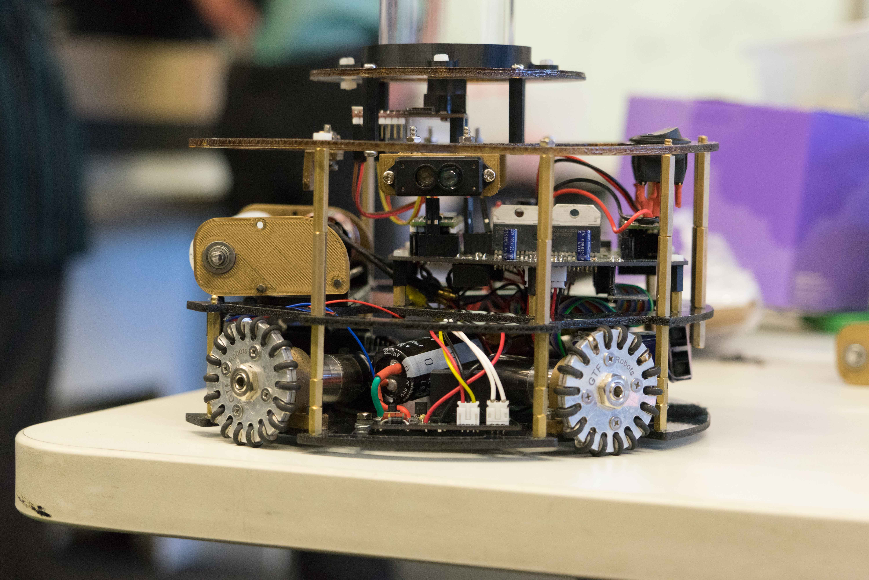
Use of Sensors
Team Apex – Australia

Slide 8
ELECTRONICS
LIDAR
Four LIDAR modules have been implemented for use in highly accurate robot positioning. Previous iterations have used a camera to calculate distance from a goal, but this served inconsistent and inaccurate. The use of LIDAR removes this issue entirely.
Light Sensors
24 Light sensors arranged a tight circular ring.
Placing the LEDs on an outer ring allowed the shrinking of the sensor circle and increased consistency in line detection
As red produces the highest contrast between red and green, it was chosen as the LED colour.
Bluetooth
Dual Bluetooth modules were incorporated for dedicated debug and inter robot communication (IRC). These Bluetooth modules allow for the transmission of key field data wirelessly. Information such as the ball location is vital when direct line of sight is required. In addition it allows for quick swapping between defender and attacker protocols.

Slide 9
360° camera
The 360 degree camera as the name suggests, allows for vision in every direction.
The assembly comprises of an OpenMV M7 Camera, 3D printed mount then a transparent acrylic tube holding up another 3D printed mirror mount.
The 360 degree function is made possible by the camera looking at a dome shaped piece of mirror.
The moulded piece of mirror was created by heating it up and forming it over a specifically designed mould.
The wide plate on the very top is there to stop interference from the camera looking at objects beyond the mirror.
Mirror mount
Moulded mirror
Transparent acrylic tube
3D printed mount
OpenMV M7 Camera

Slide 10
Game Strategy
Team Apex – Australia

Slide 11
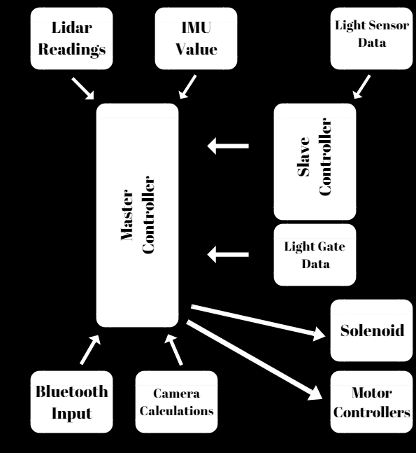
Micro-Controller
Structure
Compartmentalising key calculations across three microcontrollers effectively increases processing speed. SPI is used for Master-Slave communication between controllers, ensuring reliable and fast transmission of data. This reduces time of calculations. This also effectively splits the development of software, making future debugging and optimisation far easier.

Slide 12
Overall Logic
IMU Data
Camera Logic
Take a snapshot of the OpenMV camera
Find the ball and two goals by finding the largest ‘blob’ which is the correct colour
Transmit x and y coordinates through Serial to Master Teensy
Calculate distance and direction of the ball and two goals
Orbit Logic
Update rotation PID so the robot either faces forwards, goal tracks when attacking or faces away from our own goal when defending.
Calculate optimal direction and speed to move at to either attack or defend
If the movement will move the robot out of the field, edit the orbit direction accordingly
Motors
Calculate the speed each motor needs to run to move in the desired direction, speed and rotation
Run the motors accordingly
Light Sensor Logic
Read all Light Sensors
Calculate line angle using vector addition with respect to the robot
Check whether robot is out of the field, changing the line angle accordingly

Slide 13
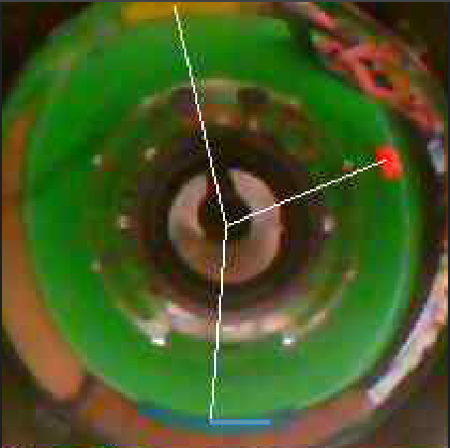
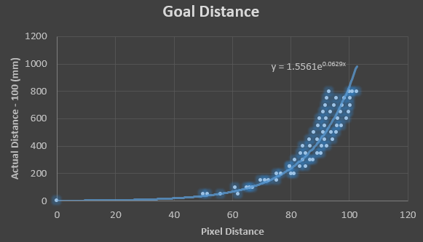
Ball and Goal Tracking:
The ball and goals are detected via the Open-MV camera. For every snapshot of the camera, the image is scanned for the colours of the ball and goals. Their x and y coordinates are sent through serial communication to the master teensy. The direction of each entity is easily calculated from their coordinates. Exponential functions were modelled so that the distance of each entity can also be calculated with reasonable accuracy. Exponential functions were required because the relation between pixels and distance was exponential due to the mirror shape.

Slide 14
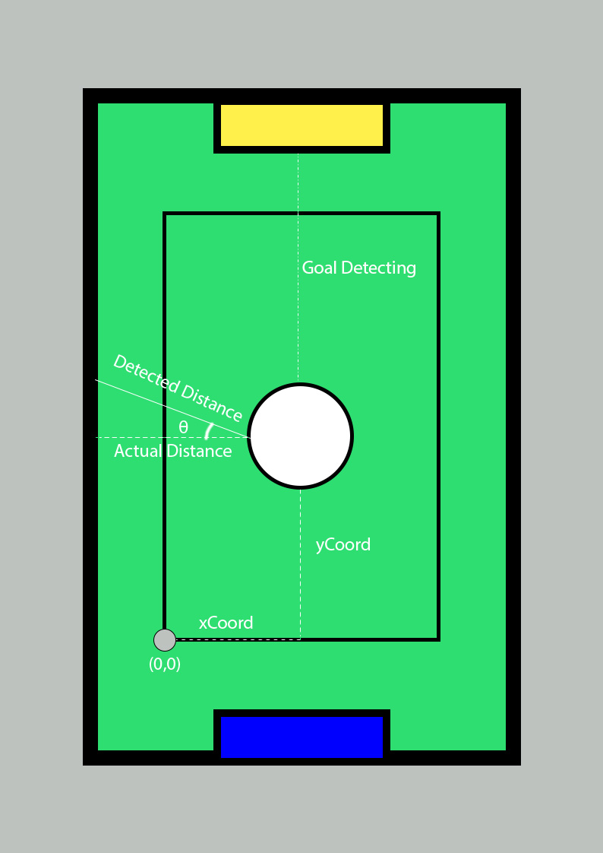
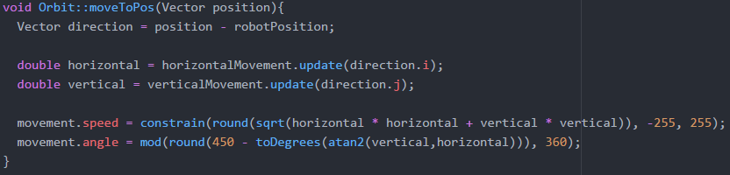
Field Co-ordinate System
Lidar logic was written with constant goal tracking in mind. The data from the onboard IMU is used in calculations to correct for the robot’s heading. This data is interpreted using simple trigonometry to develop an accurate on-field position. In conjunction with the camera, key locations are attributed with a corresponding location and transmitted to the other robot via Bluetooth. This allows for constant and accurate tracking even without line of sight. This development was found to be especially useful for superteam due to limited camera range. Location data is used to move the robot into high traffic zones such as in front of the goals.

Slide 15
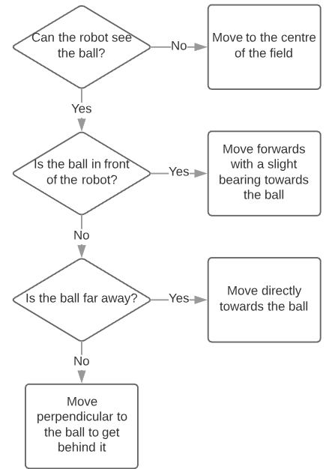
Orbit (Attacker)
The orbit is undoubtedly the most fundamental
part of the robot. There are four main parts to it.
If the robot cannot see the ball, it positions itself
in the centre of the field so that it can have the best
chance of seeing the ball again. If the ball is in front
of the robot, it moves forwards with a slight baring
towards the ball. If the ball is far away, it moves
directly towards the ball. Otherwise, it moves at an
angle perpendicular to the ball to get behind it so it
can then attack forwards.

Slide 16
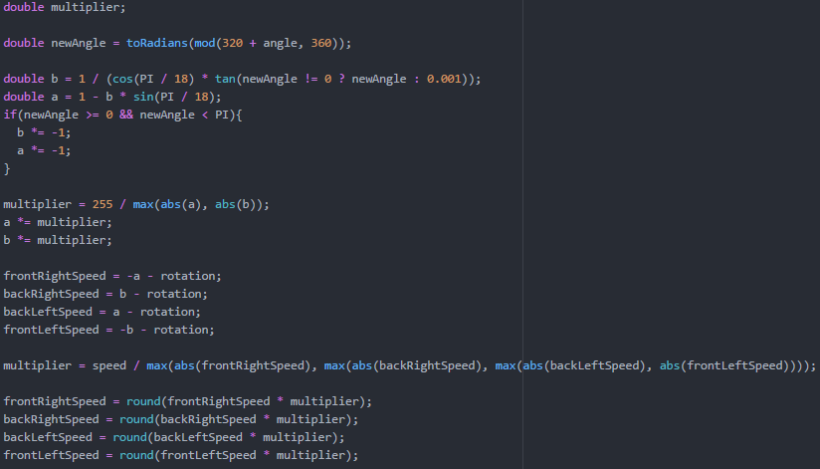
Motors
Knowing the direction, speed and rotation we want the robot to move in is all good and well but how do we physically move according to those parameters? Vector mathematics was used to calculate the relative speed each wheel needs to move in order to move in a certain direction. Each speed was scaled up to 255 before the rotation was added to rotate in the same direction. The speeds are then scaled again so that the fastest motor is at the desired speed.

Slide 17
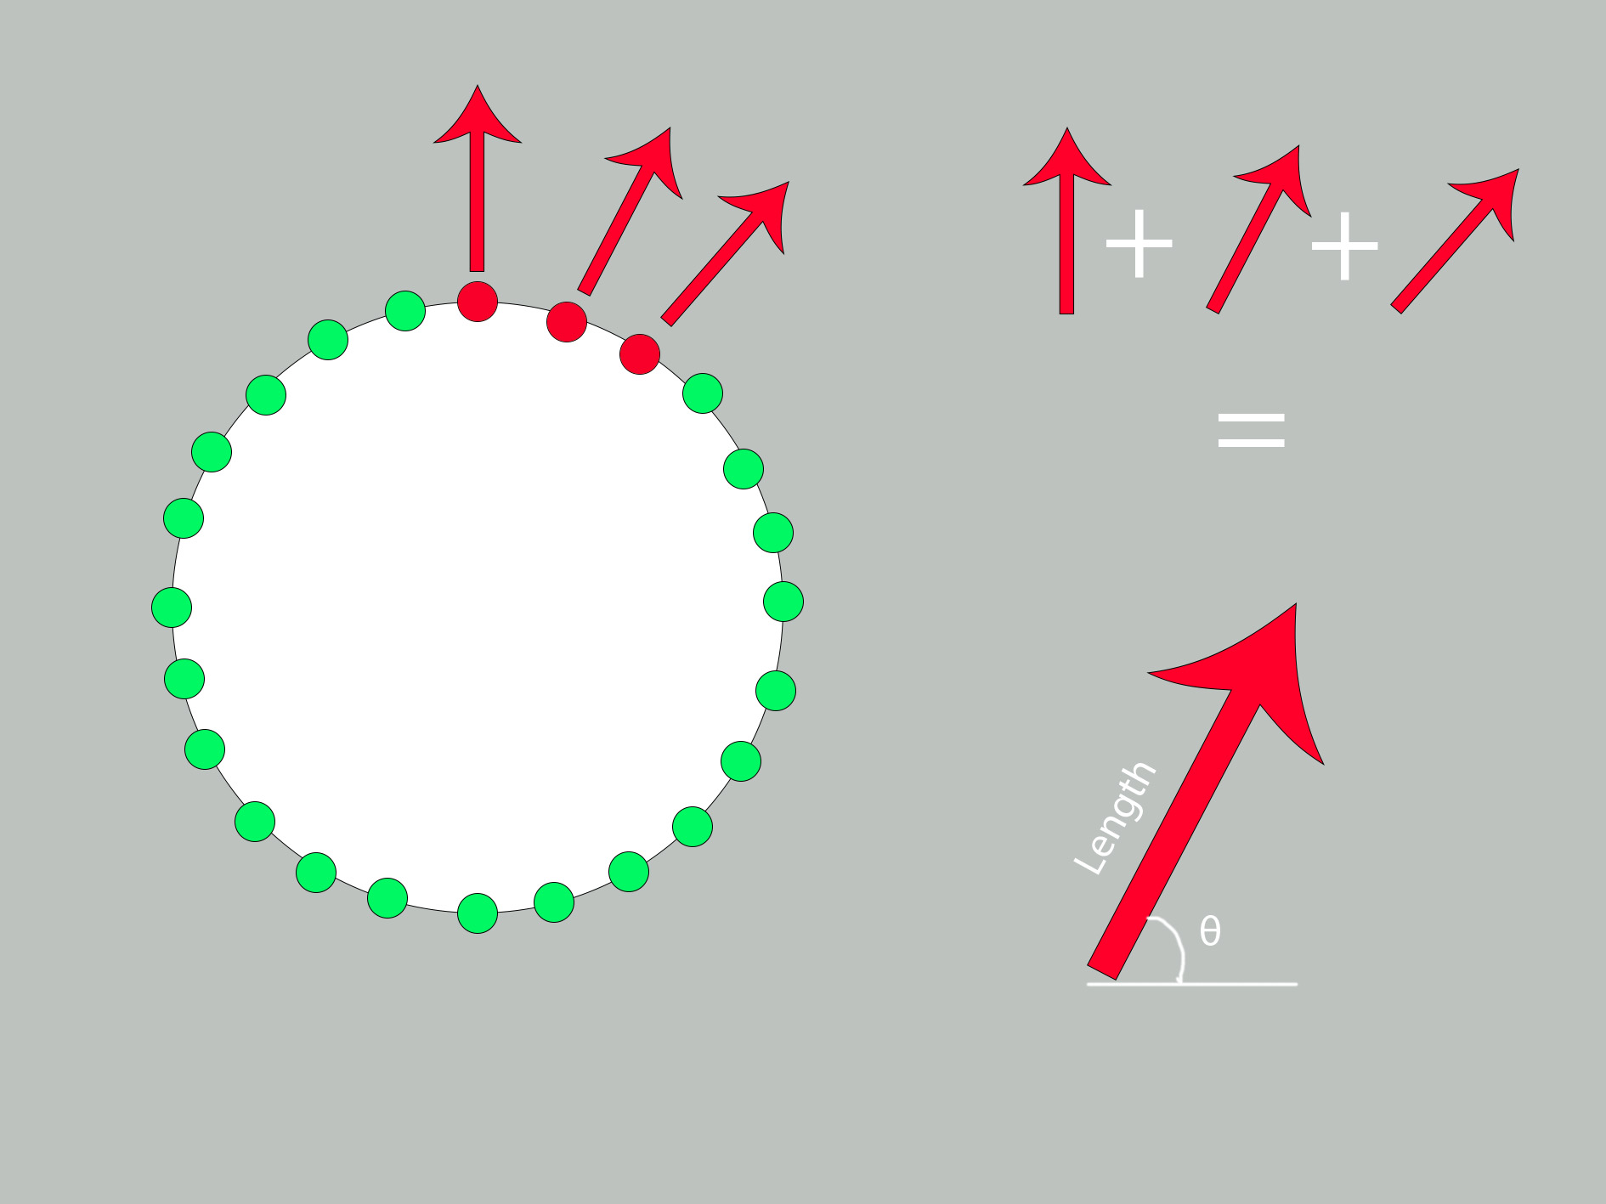
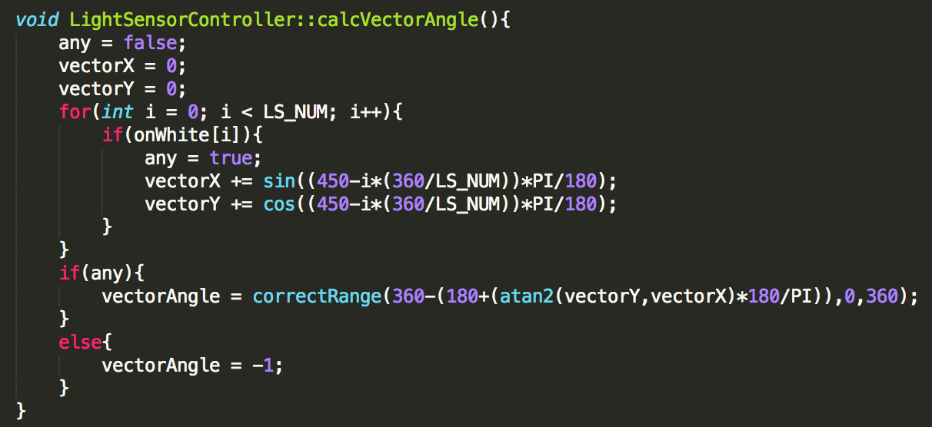
Line Avoidance
The Robot detects the line via 24 light sensors. Each light sensor has been assigned a unique vector. Upon detecting the line, the vectors of all sensors that have been triggered are summed. This produces a final vector that leads the robot back into the field of play in minimal time.

Slide 18
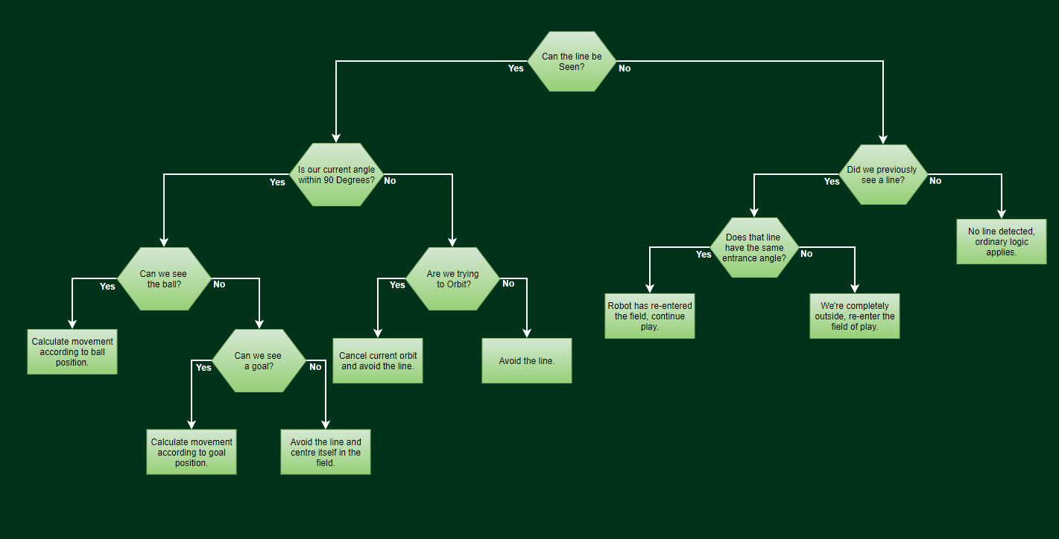
Light Sensor Logic

Slide 19
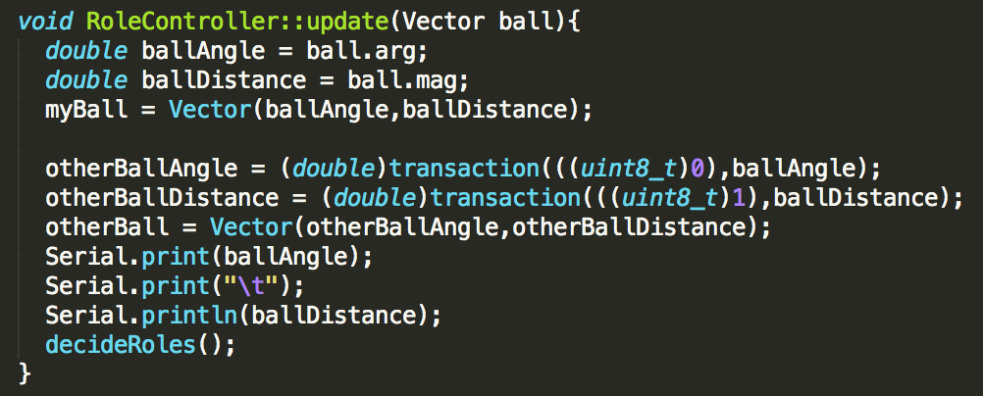
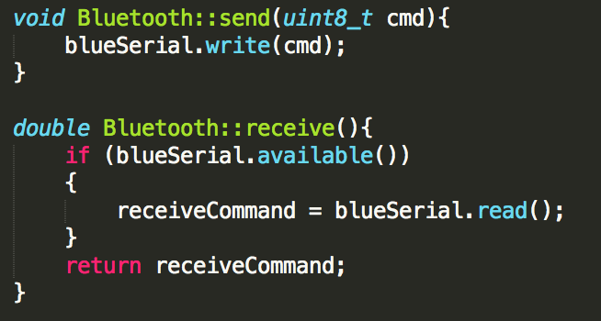
Bluetooth
Two Bluetooth modules on each robot allow for inter-robot communication. They are set up in a master-slave configuration. This allows for the inclusion of advanced strategy. These modules were used to convey key information such as ball and opposition position. This data was gathered from use of our field positioning system. Advanced strategy such as a defender swapping to an attacker depending on proximity of the ball was enabled through the use of this communication protocol.

Slide 20
Problem Solving
Team Apex – Australia

Slide 21
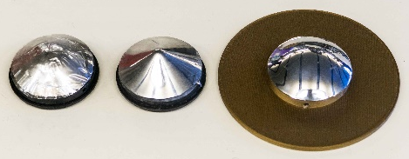
PROGRESS
Progression to Passive Ball
Focus for software was largely directed towards the transition to passive ball. One of the largest challenges was to get an accurate distance calculation for the ball and two goals (whereas in the previous year no camera was used and the strength of IR light was used for the ball). By using calculations relying on the reflection of light, a theoretical model was achieved. Unfortunately, this didn’t work practically. Due to the inaccuracy in the shaping of the mirror and other variables such as refraction, the model did not work. Instead the distance of the goals in terms of pixels was recorded against actual distance and an exponential function modelled the data. This modelled the distance of the ball and goals well, dramatically increasing accuracy.
Creation of Camera
In the development of the camera various materials and designs were tested The camera is the key component of open soccer, hence a camera and mirror that perform consistently and effectively were necessary. Chrome balls were experimented with in conjunction with a PIXY cam, but this produced poor results. A cloudy and minimal view of the field was the best that could be produced. As such, we looked into custom moulding of plastic in attempt to make mirrors with optimal angles and design. Various materials were used, but plastic coated materials melted, obscuring the mirrored surface before being properly moulded. An alternative plastic which was not hindered by this factor was sourced and results improved drastically. Mirror shapes were experimented with via CAD software, simulations being used to determine an optimum shape. A rounded mirror surface was found to be the most effective, and 3D printed for use as a mould.
Various Iterations of mirror design

Slide 22
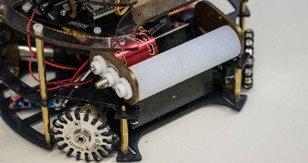
PROGRESS
Development of Dribbler
Various iterations of dribbler design and material were experimented with. A material with high durability and grip was found to be necessary to be used as a base. 3D printed shapes were coated in a variety of rubber materials and compared. These were all found to be sub-par and additional materials were investigated. Two part silicone sealant was found to be an effective material, with a high durability and grip. Following the decision of material, different design types were tried. Originally a heavy conical design was tested, but produced rotation at suboptimal angles pulling the ball from the capture zone. A spiralled design was found to only just increase the ability to centre the ball, but decreased control and consistency. Hence a plain bar shape was decided upon for simplicity and consistency.
Final dribbler design

Slide 23
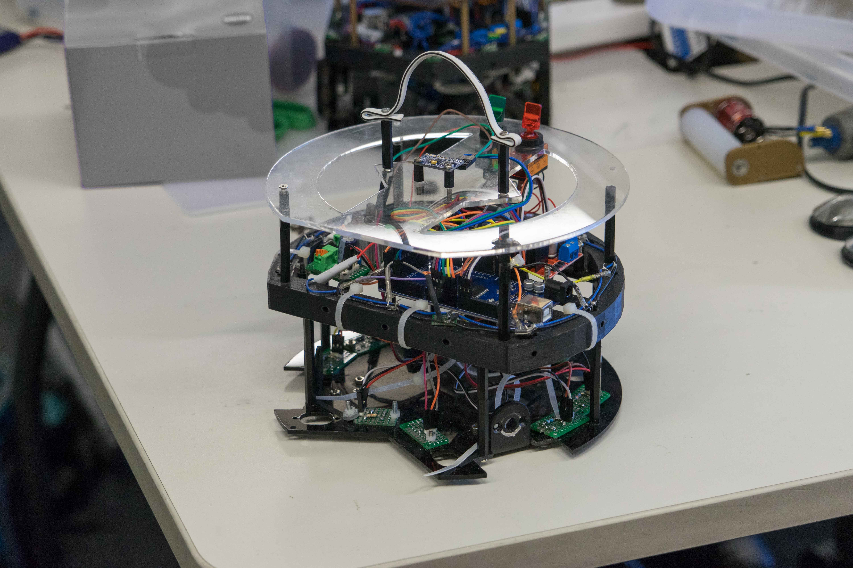
FUTURE IMPROVEMENTS
Mirror
Although we believe our mirror achieves its purpose effectively, further prevention of distortion and experimentation with further shapes, methodologies and materials could yield better results and improve our tracking ability significantly.
Camera
Cameras are the limiting factor in open soccer currently. Investigating into methods of enhancing camera quality, range and FPS would drastically improve our game quality. Ultimately, the design of our own camera is the end goal.
Apex Robot - 2018
Apex Robot - 2017

